Slide 1
Regular Expressions

Slide 2
What is a regular expression
Regular expression (RegEx, RegExp) is a sequence of symbols that denotes a search pattern
RegEx can be used in text editors or when processing textual data
RegEx are extremely useful when replacing patterns in the text
RegEx consist of either literals or metacharacters

Slide 3
Basic concepts
OR operation
grey|gray match either English or American version
Grouping parentheses ()
gr(a|e)y matches the same thing
Quantifier (matches same character multiple times)
? is 0 or 1
* is any
+ is more than 0
{min, max} is between min and max
Wildcard . matches anything other than the end of line
Metacharacters can be escaped \ and transformed into literals

Slide 4
Extra metacharacters
[…] matches any symbol inside the brackets once
[^…] matches anything but the listed symbols
[abc][^abc] matches cats
^ and $ match beginning and the end of the line
Any quantifier followed by a ? is lazy and matches as few symbols as possible
c.+t matches whole string ”cat and another cat”
c.+?t matches only “cat and another cat”

Slide 5
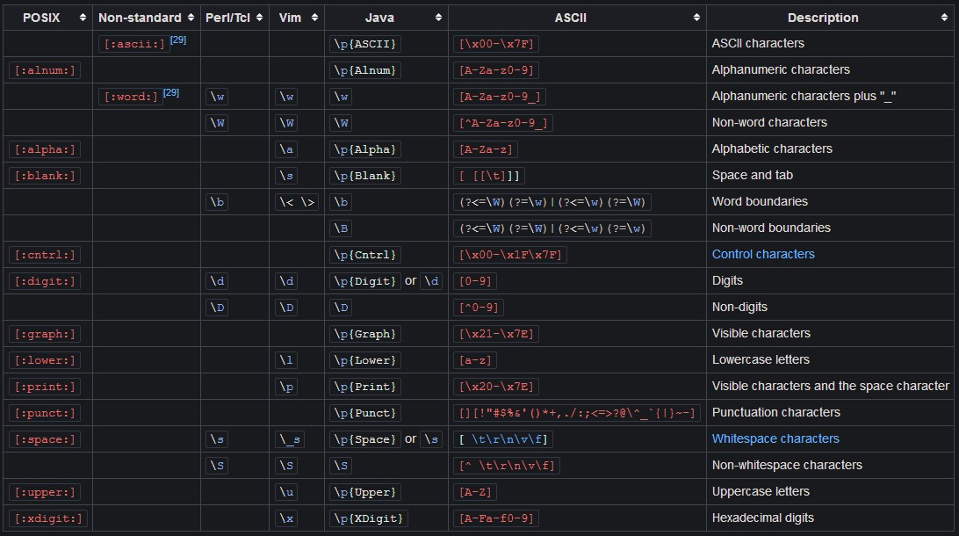
https://en.wikipedia.org/wiki/Regular_expression

Slide 6
Capturing groups
Every group in parentheses is captured and can be referred to in replacement like $n or \n
(?:) is a non-capturing group
(?:<name>) is a named capture group
(cat).*(dog) matches “a cat and a dog“
$2, a $1 replaces above match with “a dog, a cat“

Slide 7
Lookahead/lookbehind
(?=) is positive lookahead; matches expression only if succeeded by the pattern in the parentheses, without capturing what is in parentheses
(?!) similar, but works if next expression does not match
(?<=) same, but tests preceding expression
(?<!) works if preceding part of the string does not match the expression

